Slide 1






Slide 2



Company and Organization
3 DECADES OF EXPERIENCE
TM Systems, your trusted ICT (Information, Communication and Technology) consulting partner, excels in Software and Product Engineering, Cybersecurity, IoT development, and Forensics.
We leverage AI, ML, and Automation for Digital Transformation and Data Engineering. Our expertise extends to Business and Knowledge Process Outsourcing, Product Strategy, DevSecOps, and UI/UX Design Consulting. At the heart of our services is a commitment to simplifying technology while ensuring total security.
Our goal is to be global leaders in Information Communication Technology Consulting and Transformation with Security at the core.
We prioritize security threats and aid our clients to spot, prevent, and reduce risk in the most cost-effective way possible.
CLIENTS AND ORGANIZATION
With a 93% retention rate, our clients are used to the to the high-quality work, agile processes, innovation driven team and our customer support.
We are an ISO 27001:2022 and ISO 9001:2015 certified company embedding quality and commitment in every project we do.

Slide 3
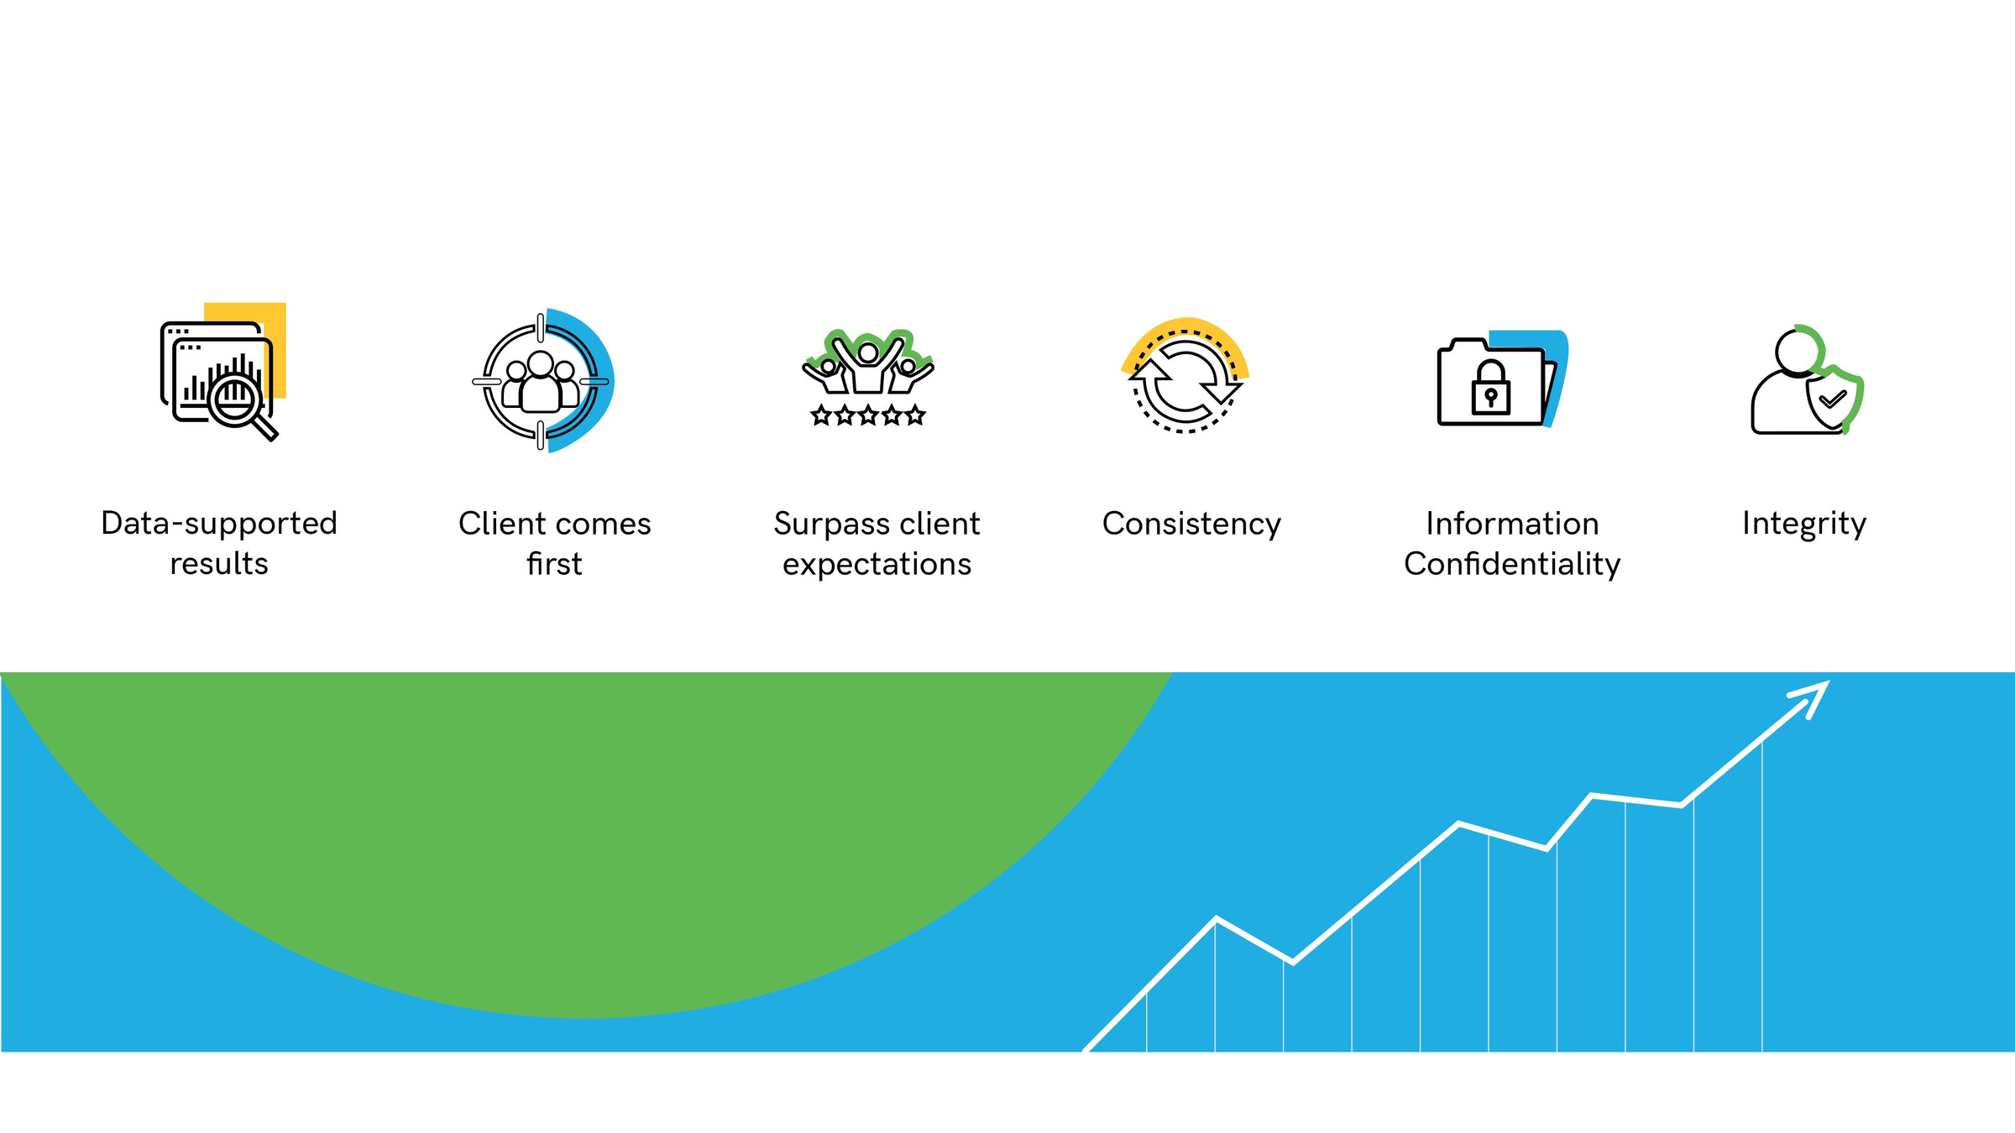

Our Values
3 DECADES OF EXPERIENCE
TM Systems, your trusted ICT (Information, Communication and Technology) consulting partner, excels in Software and Product Engineering, Cybersecurity, IoT development, and Forensics.
We leverage AI, ML, and Automation for Digital Transformation and Data Engineering. Our expertise extends to Business and Knowledge Process Outsourcing, Product Strategy, DevSecOps, and UI/UX Design Consulting. At the heart of our services is a commitment to simplifying technology while ensuring total security.
Our goal is to be global leaders in Information Communication Technology Consulting and Transformation with Security at the core.
We prioritize security threats and aid our clients to spot, prevent, and reduce risk in the most cost-effective way possible.
CLIENTS AND ORGANIZATION
With a 93% retention rate, our clients are used to the to the high-quality work, agile processes, innovation driven team and our customer support.
We are an ISO 27001:2013 and ISO 9001:2015 certified company embedding quality and commitment in every project we do.

Slide 4
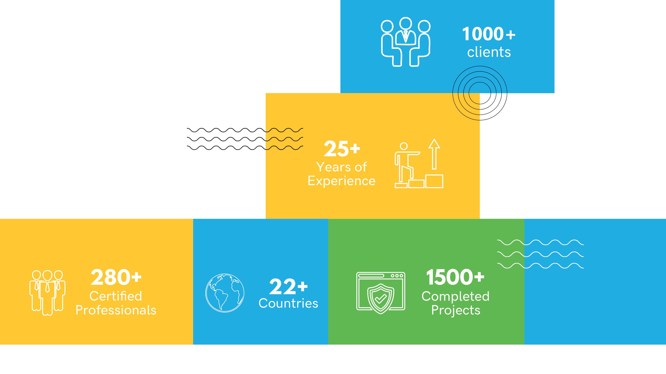
Numbers

Slide 5

Journey
Year 1994 | Company was founded
2000
2019
LAUNCHED CORE BANKING SOLUTION PRODUCT
LAUNCHED CLUBSOFT
2017
2025
CYBERSECURITY CONSULTING BUSINESS STARTED
LAUNCHED TICKETBOARD
1998
LAUNCHED
AUTOBANK
1999
2008
2018
2022
MICROSOFT GOLD PARTNER
INTERNATIONAL EXPANSION OF TEAM AND BUSINESS
THE USA, EUROPE, UAE, AUSTRALIA, SINGAPORE AND NEW ZEALAND
SAP PARTNERSHIP
SETUP OF EU OFFICE FOR OFFERING SERVICES AND PRODUCTS

Slide 6
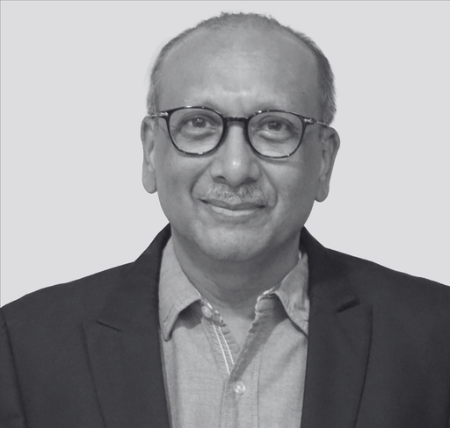
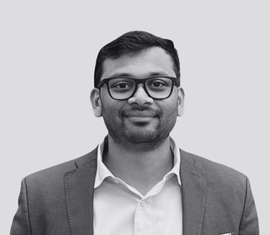
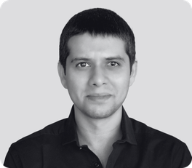
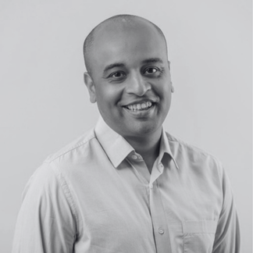

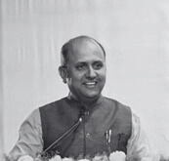
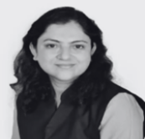
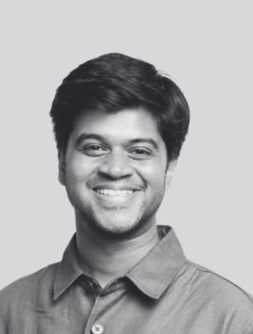
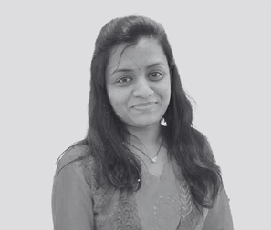
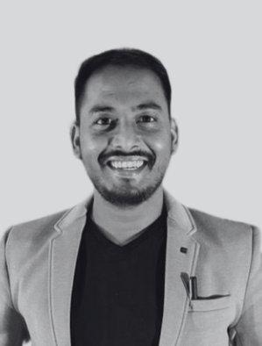
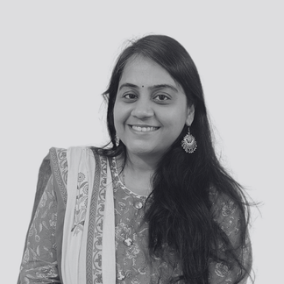
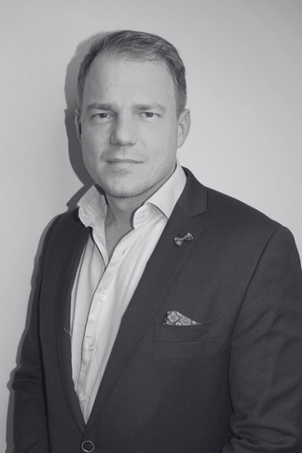
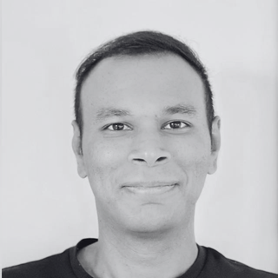
The Team
LEADERSHIP
TM Systems team has of 280+ dedicated engineers, designers, managers, strategists and business minds building products and providing services .
Saumil Shah
Shravan Shah
Sahil Shah
Kunal Shah
CHIEF EXECUTIVE OFFICER
DIRECTOR
DIRECTOR
DIRECTOR - OT SECURITY
Adv. (Dr.) Swapnil Bangali
Adv. (Dr.) Harita Shinde Bangali
Kushal Shah
Nehal Shah
VP - LEGAL SERVICES
LEGAL HEAD
BUSINESS LEAD- EUROPE
SENIOR MANAGER – CLIENT RELATIONS
Rahul Yadav
Samiksha Chauhan
Boy Striker
Rohan Talati
CHIEF TECHNOLOGY OFFICER
HR MANAGER
BUSINESS DEVELOPMENT MANAGER - EUROPE
HEAD - AI & DATA SCIENCE

Slide 7

CLUBSOFT
Discover ClubSoft from TM Systems, a comprehensive software designed to streamline club administration and facilitate interaction with members. ClubSoft empowers your club’s business.
ClubSoft is Integrated software product that handles all aspects of any kind of Club, Gymkhana and sports venues. The product handles everything from member management to club operations specifically the financial aspects. ClubSoft is web and mobile app ready, flexible to accommodate any kind of activity your club might cater to. Members can use touch screens, kiosks, contactless cards or even bio metrics to access. The product works at major elite clubs across India.

Slide 8
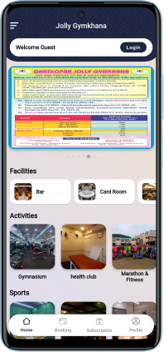
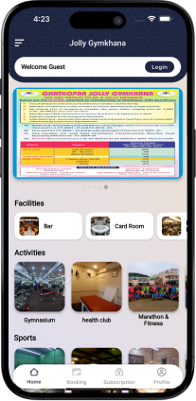
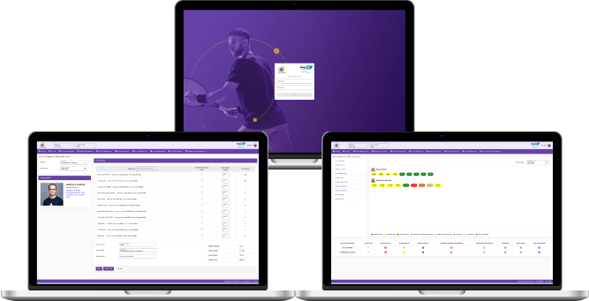


Mobile and Web app

Slide 9

Members Management
Managing members easily
  Members related management services - New Memberships, Cease/death/transfer Memberships, Life Memberships, Ordinary Membership, Temporary Memberships, Institution Memberships etc can be managed
  Accounting module for admin to check the activities that members do
  Smart handling of Members privileges based on defined rules and regulations by the Administrators of the club
  All Members and their membership data will be linked through issued Identity Cards, Smart cards or Prepaid Cards to use it on the club premises

Slide 10
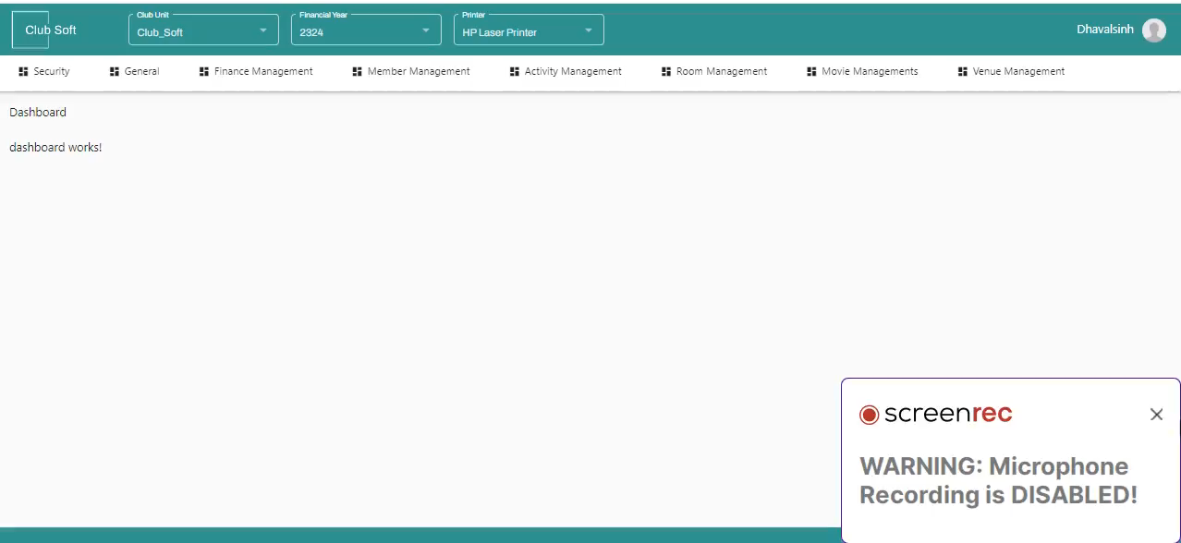
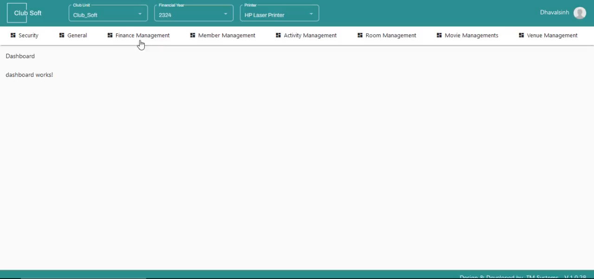

Members Management
Member Creation
Member KYC Document Upload

Slide 11

Rooms / Venues Management
Manage Rooms and Venues easily
  Rooms and Venues booking/cancellation/availability functions for administrators and members
  Check in/Check out functions for rooms
  Bill Generation function
  Credit/Debit card handling function
  Automated entries to accounting system functionality
  Rooms and Venues booking also available through the Member section in the web based application

Slide 12
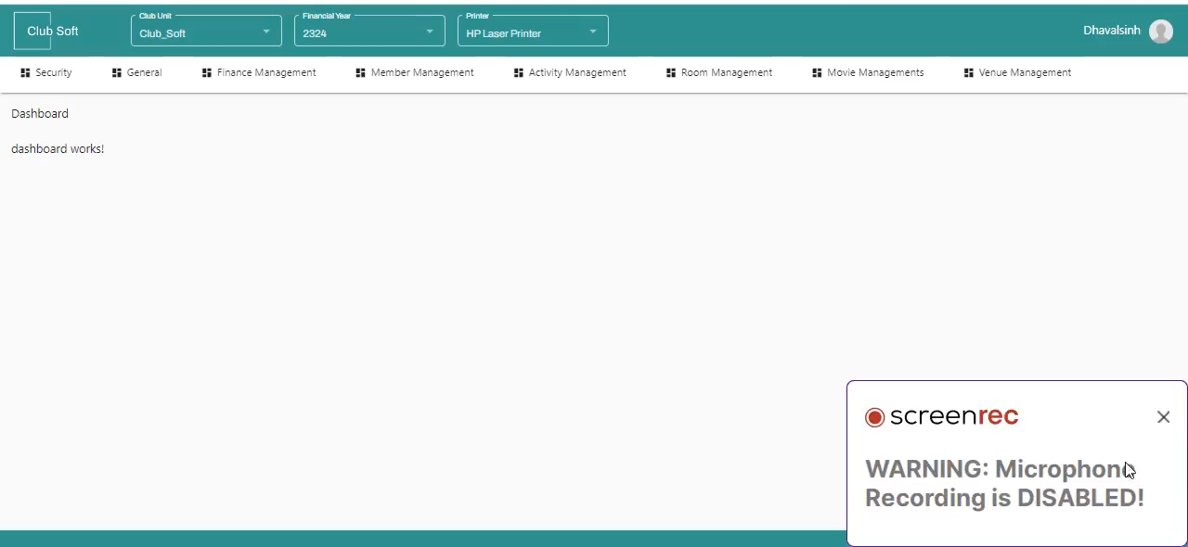
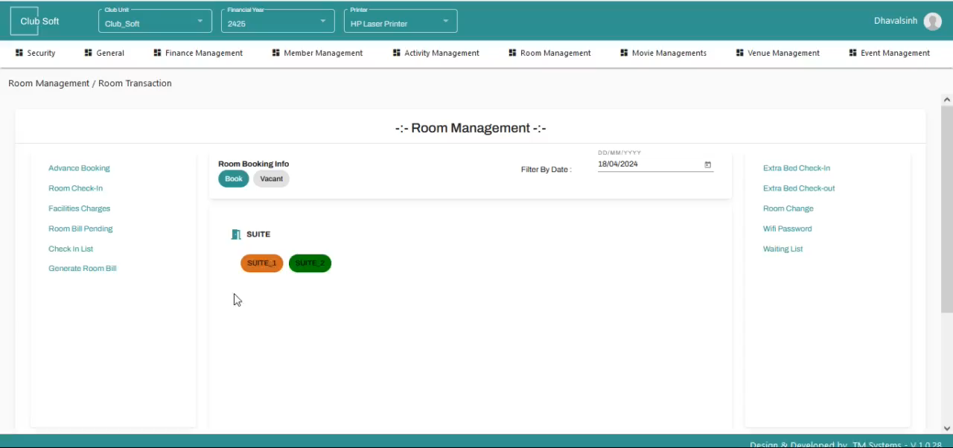
Rooms / Venues Management
Rooms Setup
Room checkout & billing

Slide 13

Activities Management
Manage activities easily
  Dynamic addition of unlimited type of activities
  Charges can be defined in various ways, Daily/Monthly/bi-monthly/half-yearly/Yearly
  Guest Charges
  Per game/Per Hour/Per Session Charges
  Automatic link to Accounts module with an easy interface
  One in all Card based access for all activities

Slide 14
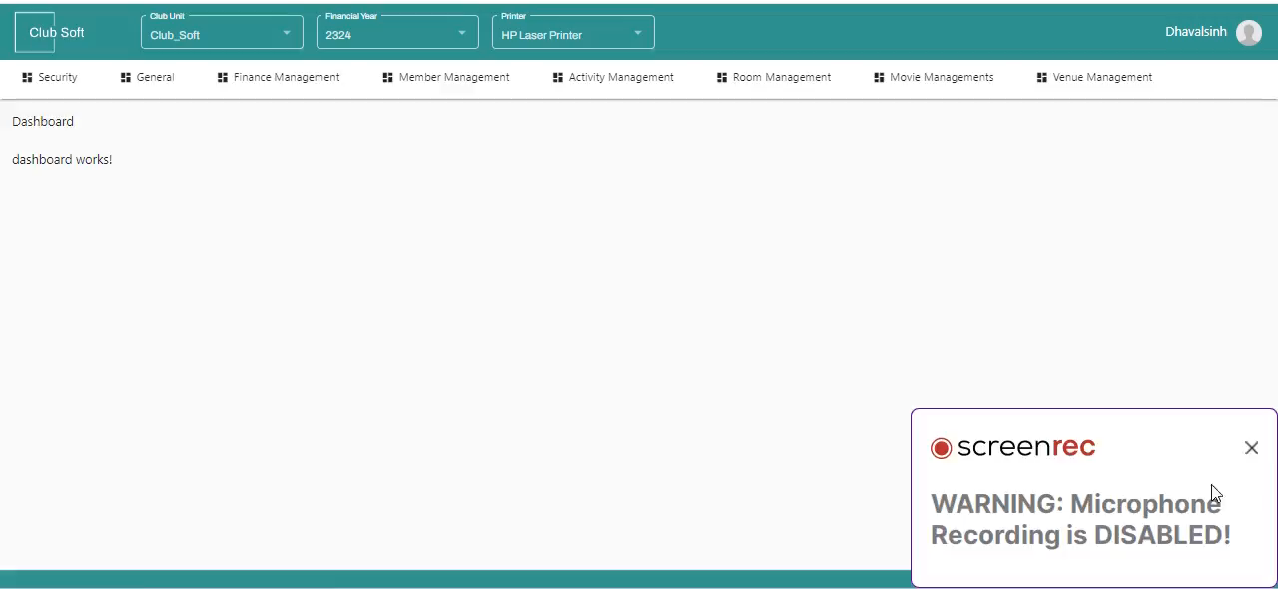

Activities Management
Create / define new activity
Activity registry entry (manual)

Slide 15

Accounting
Seamless Accounting and Finance
  All types of vouchers like bank/cash/JV/debit/credit notes are integrated
  All typical vouchers required by a club
  All sub ledgers and general Ledger facility is available
  Cross Balancing of Sub ledger and General Ledger
  All standard reports for day to day work and auditors
  Generation of Trial Balance, Profit and Loss and Balance Sheet
  Fixed Assets and Depreciation sub module

Slide 16
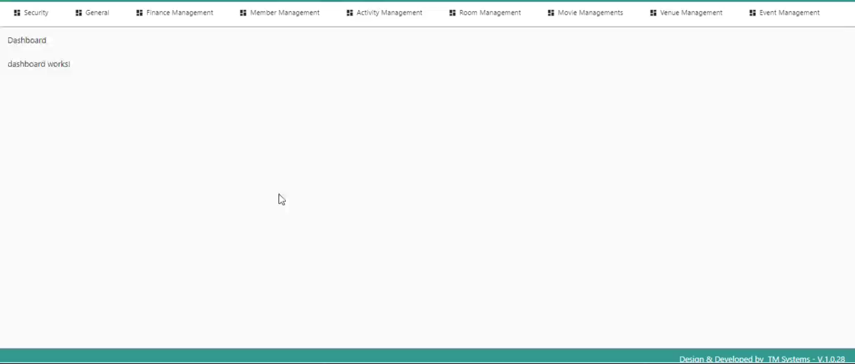
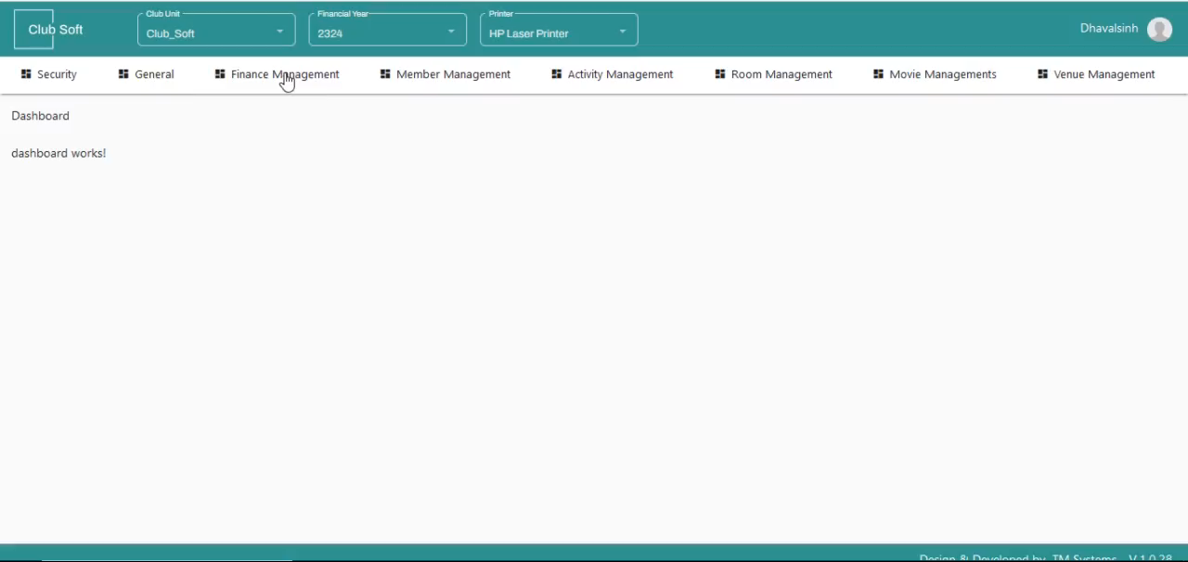
Accounting
Account Master
Sales Invoice

Slide 17

Food and Beverages with Bar module
Seamlessly manage Food and Beverages
  List of items available with price and quantity
  Automatic Kitchen Order Ticket generation
  Interface for Members for available items of food and beverages
  Cash/Credit Bill Generation
  Day Begin/Day End operations
  Automatic interface for accounting administrators
  Tablet based order taking App is also integrated with this module

Slide 18
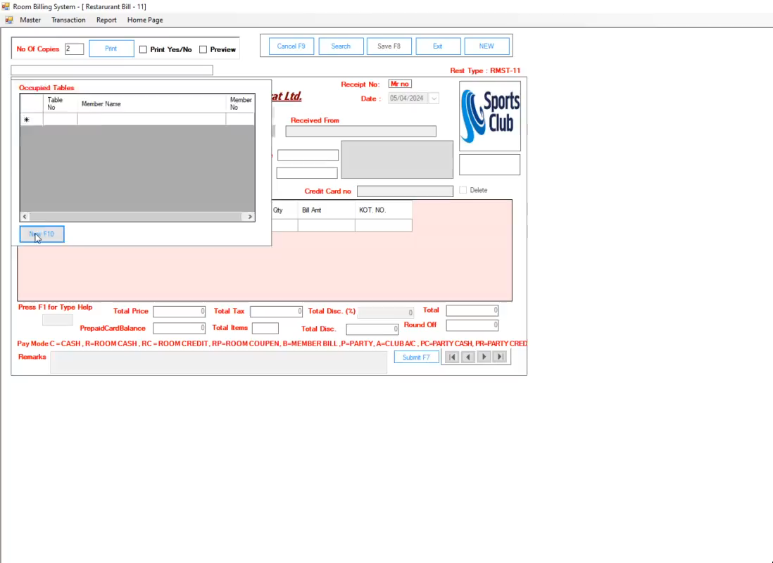
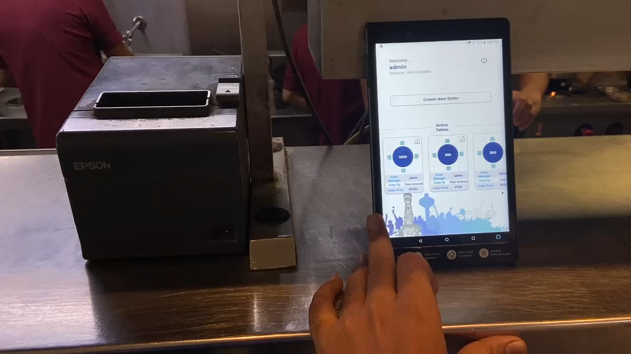
Food and Beverages with Bar module
Restaurant billing POS
Order on TABLET

Slide 19


Smart Card Interface
ClubSoft interacts with any kind of smart card (Contact or Contactless) We also give an option to develop any kind of smart card from design to encoding. Smart cards are used by members for various activities on the club premises
MIS and Reports
MIS and reporting module is used to take out variety of reports for day to day use, auditors use, record keeping use and MIS use.

Slide 20
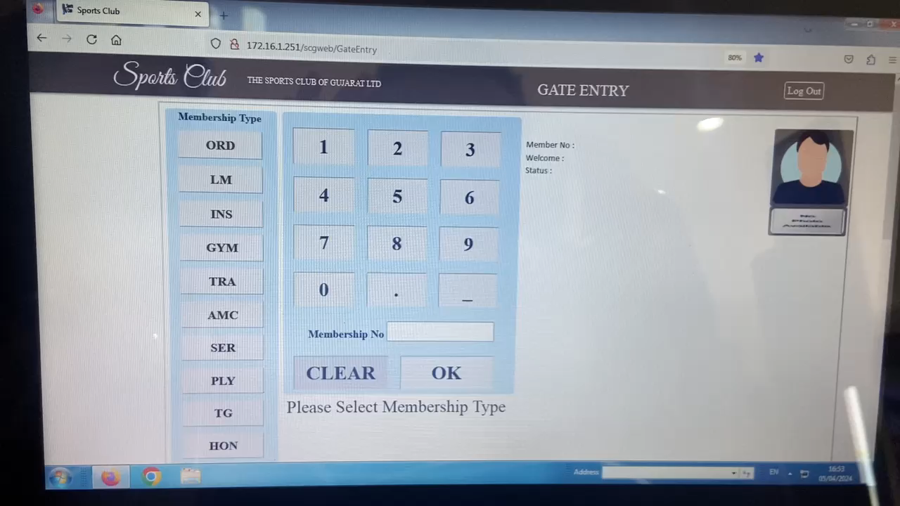
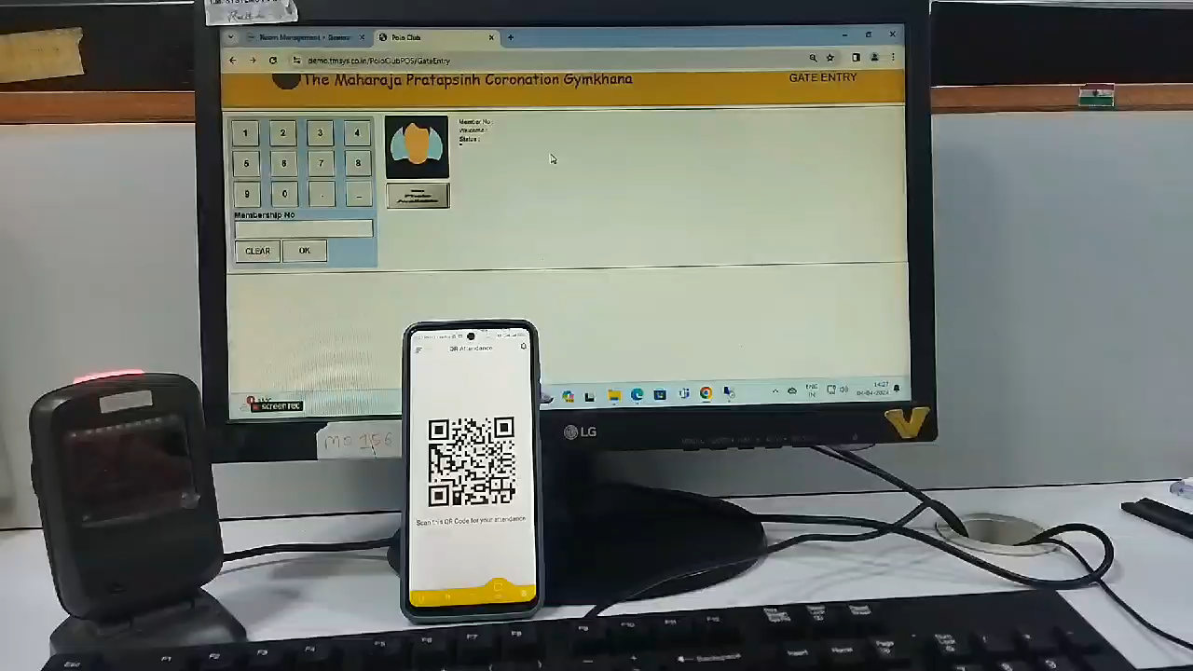
Club Entry
Gate entry touchscreen
Gate entry QR code

Slide 21

SMS and Email Integration
Send Messages easily
  SMS and Email registration of each member
  Send bulk SMS or bulk Email any kind of message to the club members
  Automatic SMS / email notification for facilities used by the member and their family.
  Automatic SMS / email notification about monthly bill

Slide 22

Web App Portal
The web App portal will be a central Web Presence for Administrators of the club
  Standard Information about the club which will change only once a year
  Variable information about the club, relating to activities, functions, events which will change often
  Rates of activities in the club
  Member Login
  Member dues payment
  Member details self-updates (only allowed fields)
  Movie booking
  Facilities and Activity bookings
  Rooms status view / booking
  Library Books Booking
  View Food & Beverages bills

Slide 23

Mobile App
The Mobile App will be for the members to access all information of the club
  Managing member details
  Member dues payment and bill lookup
  Member details self-updates (only allowed fields)
  Movies / Events booking
  Facilities spot booking
  Rooms and Venues booking status view / booking
  QR Code for gated entry during movie shows and other events.
  Money Wallet (optional) for payments within the club premises
  Library Books Booking
  Instant view Food & Beverages bills
  Historical data of activities and facilities used by members and family members

Slide 24
CLUBSOFT SUCCESS STORIES

Slide 25

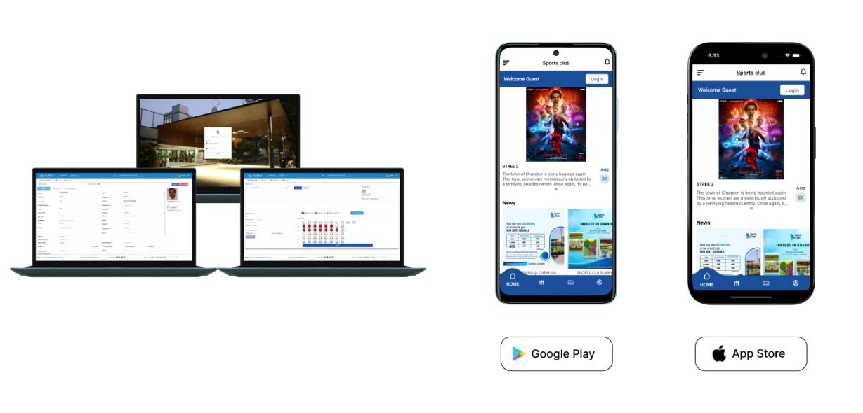
Sports Club of Gujarat - Ahmedabad
Success Story: Sports Club of Gujarat, Ahmedabad switched to ClubSoft in 2017
Location: India
Introduction: The Sports Club gets its flamboyant and elegant design in the heart of city from the renowned architect Charles Correa who also happens to be the designer of the soulful Gandhi Ashram. With a beautiful design and sprawling space; Sports Club has gradually spread its branches for other sports and has become an epitome of entertainment and leisure in the thriving city of Ahmedabad. Today, Sports Club is one of the most regal clubs of Ahmedabad and renowned for its state-of-the-art amenities and splendid aura.
Challenge: Make Club management seamless, efficient and optimized to serve the members better.
Our Solution: ClubSoft! – Empowering your club’s business. Our Club Management solution was implemented at the Sports Club of Gujarat.
Impact: Roll out of Mobile app and web app simultaneously helped the Administration and Members to manage everything at touch of their fingertips. Club Administration work reduced by 40% due to digitalization. Members interaction with club activities increased by 60%. Ease of access of all kinds of information for the members made things really easy.

Slide 26
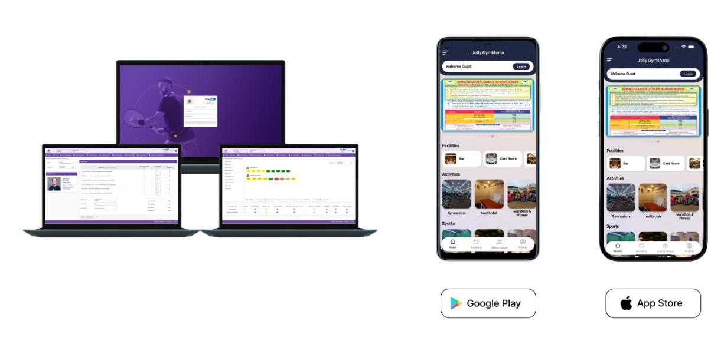
Jolly Gymkhana - Mumbai
Success Story: Jolly Gymkhana – Mumbai switched to ClubSoft in 2024
Location: India
Introduction: Established in 1950, Ghatkopar Jolly Gymkhana was founded by 60 founder members. It is one of the oldest and most prestigious Gymkhana in Mumbai. Gymkhana has changed beyond recognition from merely a Cricket club to a modern Gymkhana with all club facilities. The Gymkhana today provides State-of-Art Gymkhana sport facilities like Badminton Courts, Tennis Courts, Squash Court, Billiards, Multi Turf, Chess and Carrom.
Challenge: Make Club management seamless, efficient and optimized to serve the members better.
Our Solution: ClubSoft! – Empowering your club’s business. Our Club Management solution was implemented at the Jolly Gymkhana in Mumbai.
Impact: Roll out of Mobile app and web app simultaneously helped the Administration and Members to manage everything at touch of their fingertips.
Club Administration work reduced by 30% due to digitalization. Management and Admin are really happy with automatic Reports and accounting integration.
Members interaction with club activities increased by 40%. Ease of access to all kinds of club activities and information for the members on the mobile app has made them very happy.

Slide 27
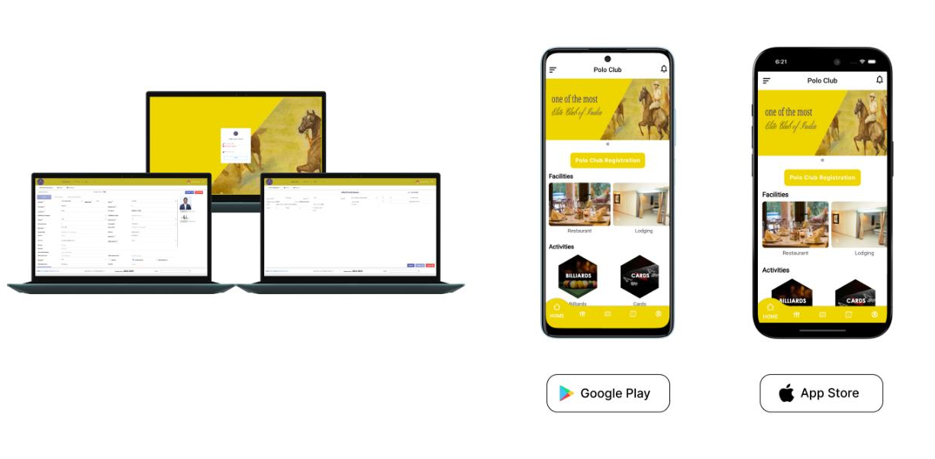
The Maharaja Pratapsinh Coronation Gymkhana- Baroda
Success Story: The Maharaja Pratapsinh Coronation Gymkhana, Baroda switched to ClubSoft in 2021
Location: India
Introduction: Established in 1941, the Polo Club of Baroda is one of the elite clubs of India, dating back to the imperial times of the Raj and has many nostalgic memories under its fold.
Challenge: Make Club management seamless, efficient and optimized to serve the members better.
Our Solution: ClubSoft! – Empowering your club’s business. Our Club Management solution was implemented at the The Maharaja Pratapsinh Coronation Gymkhana in Baroda.
Impact: Roll out of Mobile app and web app simultaneously helped the Administration and Members to manage everything at touch of their fingertips.
Club Administration work reduced by 40% due to digitalization. The Management and Administration staff is really happy with automatic Reports and accounting integration. Members interaction with activities of the club has increased by 50%. Ease of access, payments and notifications to all kinds of club activities and information for the members on the mobile app has made them very happy.

Slide 28
























Our Partners
We Partner with the best technology companies on the planet to help our clients turn their ideas into reality. Our partners are in every spectrum of Information Technology domain.

Slide 29






























Customers

Slide 30



Contact Us
We’re Here to Help You
We’d love to hear from you. Fill in the form or just book a meeting.
Visit Us
Call Us
Mail Us
Mail Us
Ahmedabad - India
India : +91-7940504060
contact@tmspl.com
contact@tmspl.com
Rotterdam - The Netherlands
India : +91-9909348410
The Netherlands: +31 10 899 8276

